Slide 1


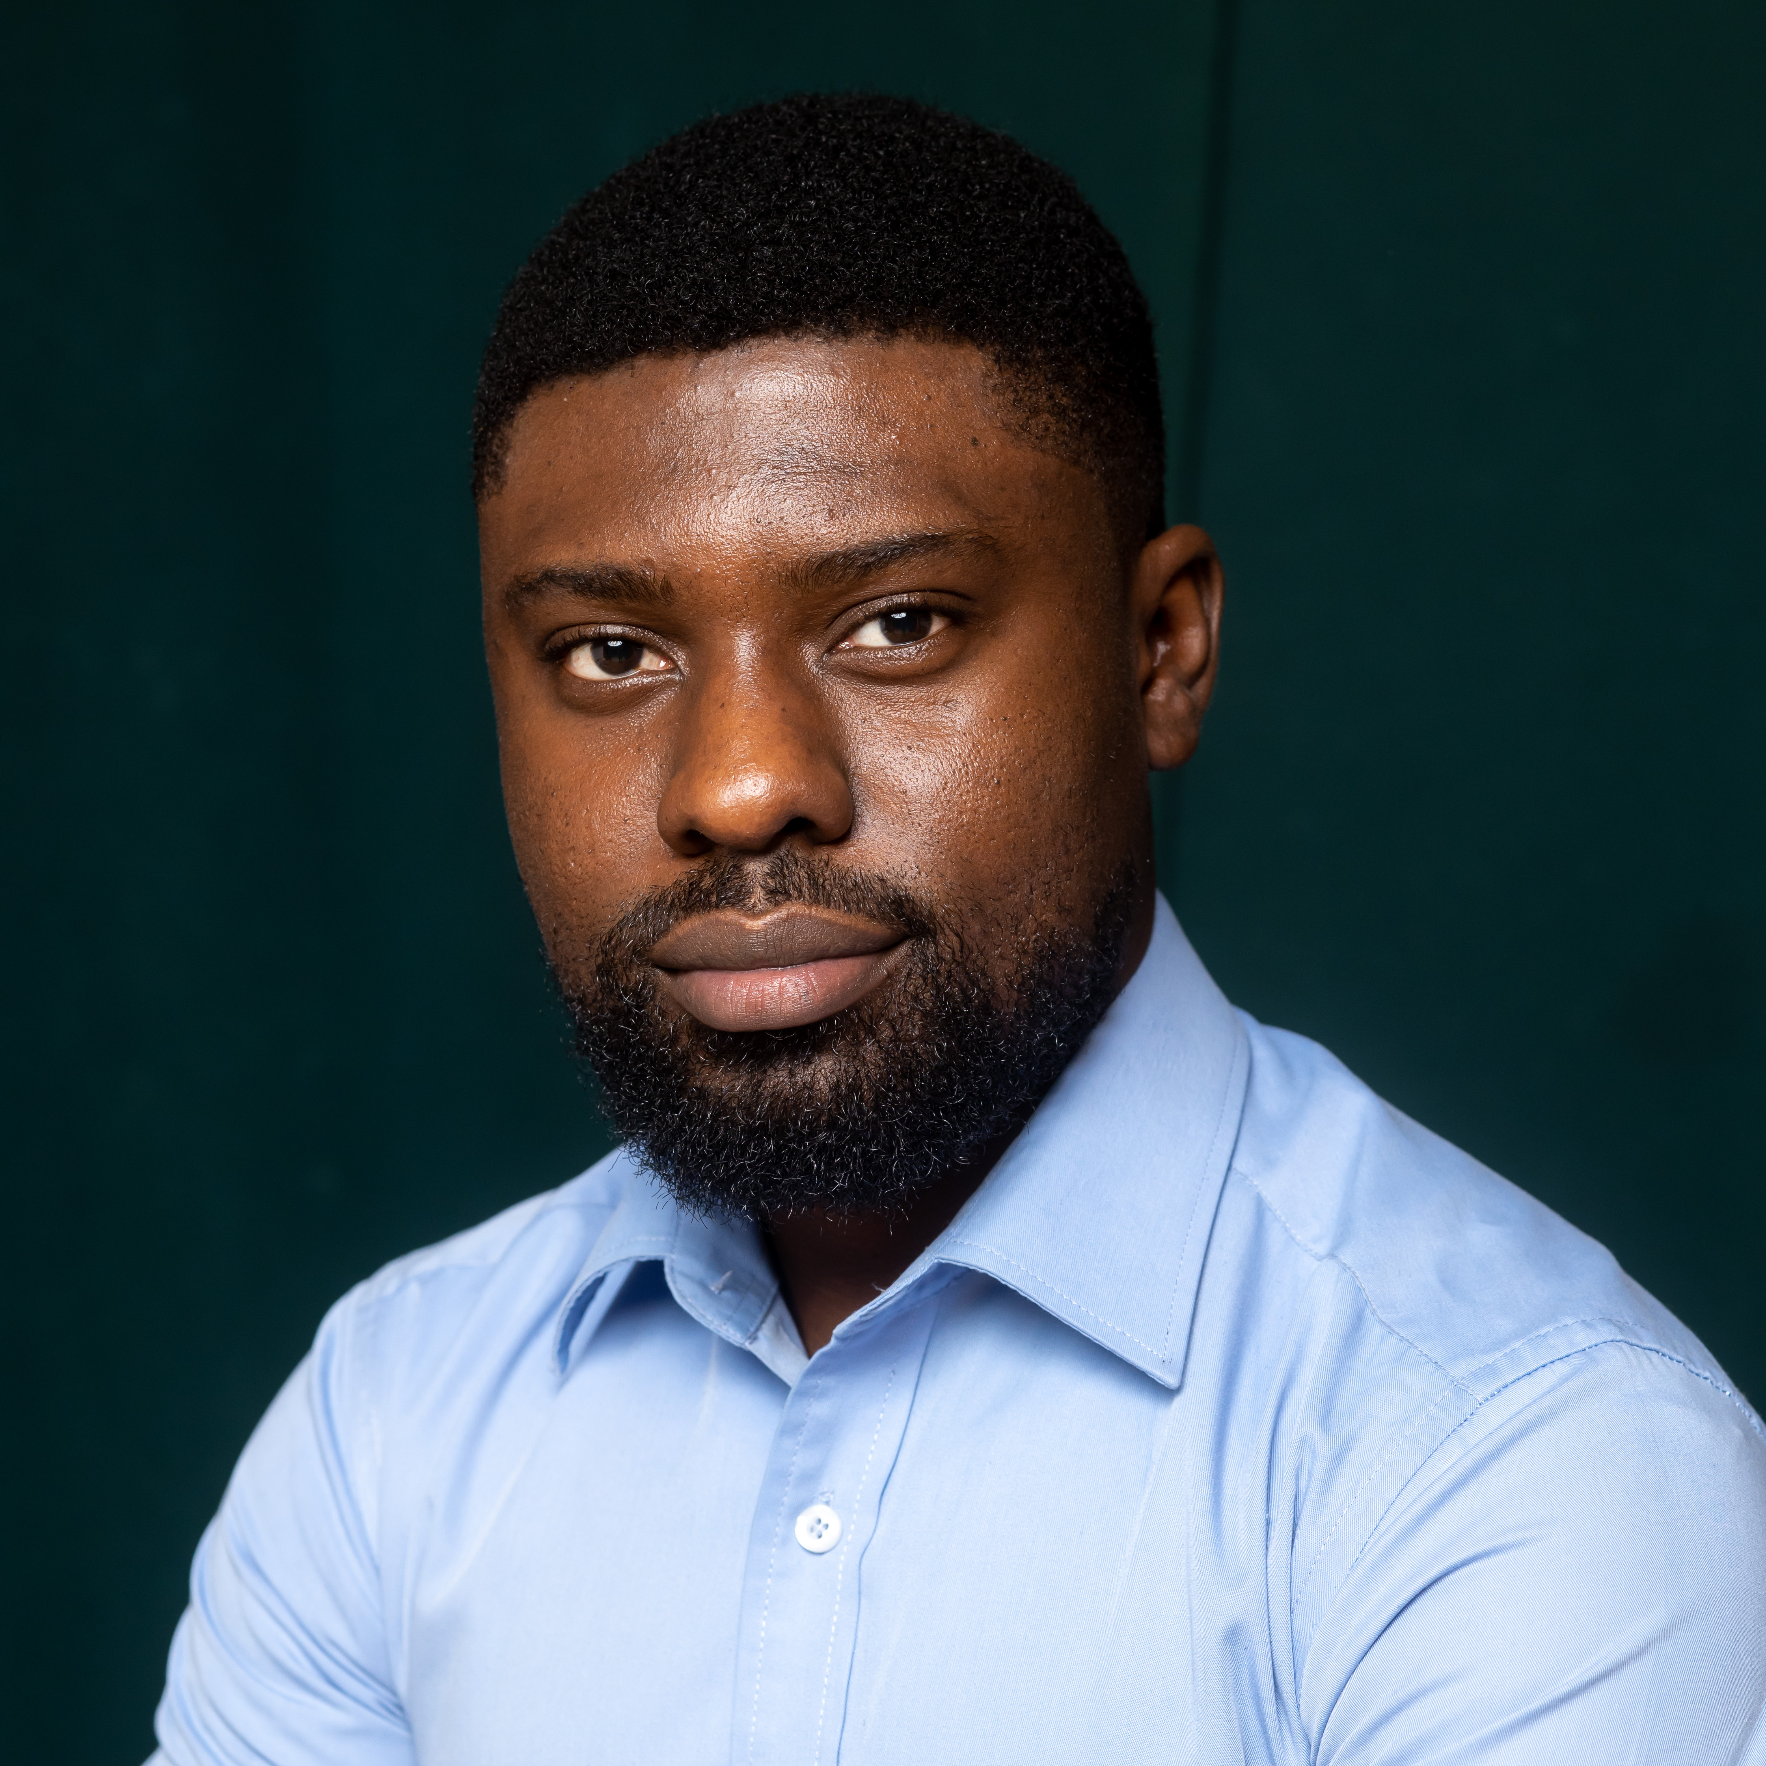

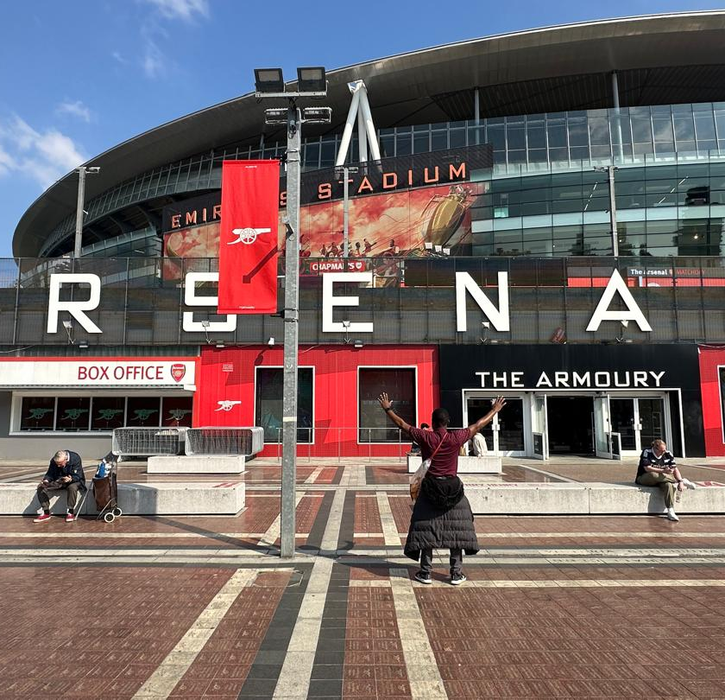
Getting to Know Me
Work
Personal
My role
Regional Talent Acquisition Manager – Africa & MENATI
Significant others / family members / furry friends in my life
Daddy’s Girls – Vanessa, Kayla and Brielle
Tenure in ofi/Olam
3 years 5 months
How I enjoy spending my free time Dancing
Previous companies I have worked at
Nestle, Antal International
My favorite / comfort food
Pounded Yam, Egusi Soup and Goat Meat
Why I joined ofi/Olam and what keeps me here?
I joined ofi to make impact. What keeps me here is the continuous personal and professional growth, along with the amazing team I get to work with every day
My favorite song
Me Leva Contigo – Rui Orlando
Samuel
Sowah
Sam
When I’m not busy sourcing talent, I’m either teaching and dancing Kizomba (a couple’s dance), volunteering with Lions Clubs International, or passionately cheering on Arsenal FC—still holding out hope for that long-awaited trophy!
This is me outside work, doing stuff I enjoy in my life …

